Slide 1

Concerning Death and Resurrection
Living in Light of The Resurrection
Week 71
29 November 2023

Slide 2

1 Corinthians Introduction
As we continue our study in First Corinthians, we want to remember that the theme of this letter revolves around Christian Conduct in the local church and how it influences unity, discipline, and spiritual growth …
Again, the primary issue in the church at Corinth was “Progressive Sanctification” – the development of Holy character and the application of Christian principles and discipline on an individual and corporate level. So the corrective in this letter is behavior rather than doctrine.
In this study, Paul addresses some doubts and misconceptions the Corinthians have about the resurrection of the dead, and he reinforces its importance to the Christian belief. Emphasizes the certainty of Christ resurrection, the order of resurrection, and the consequences of denying the resurrection. He also calls for a moral and spiritual awakening and gives a warns against the destructive influences of incorrect beliefs and behaviors.

Slide 3
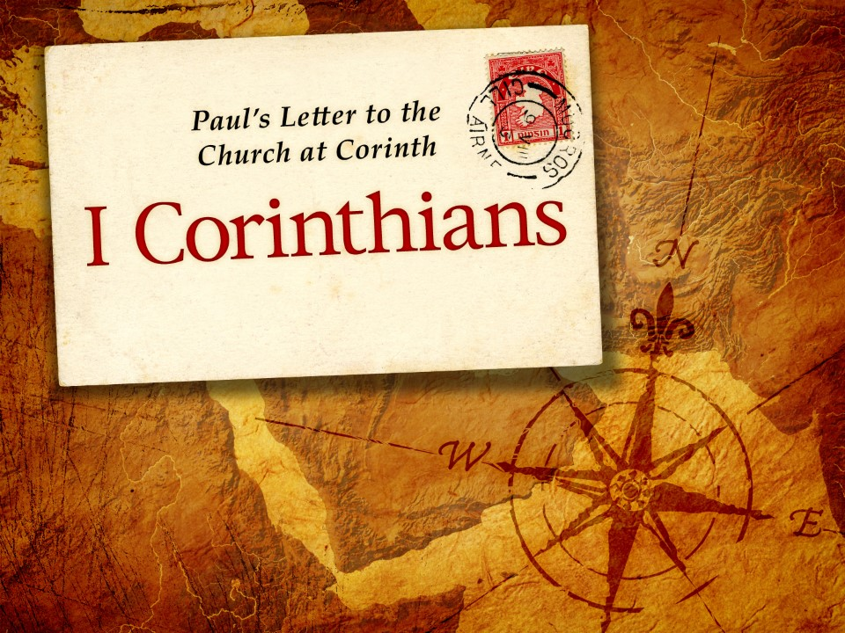
Living in Light of the Resurrection
15:12-34

Slide 4
1 Corinthians - Lesson Overview
Swindoll opens our study with these words . . . “After hitting the snooze alarm, the phone rings, you stumble out of bed fumble clumsily for the phone, as it rings again.
You pick it up and listen to a wavering, grief-stricken voice trying to get the words out. The new shocks you.
Suddenly, unexpectedly, death has claimed some one else. Maybe this time it is a parent, grandparent, a brother or sister, or a close friend.
In any case, when news of the death of a loved one reaches us, we feel stunned. Disbelief, confusion, and grief lead to lingering remorse.
Wave upon wave of choking sorrows well up within us as we do our best to believe what we’ve just heard.”

Slide 5
1 Corinthians - Lesson Overview
Death. We’ve all felt its sting. But for those of us who believe in Christ, there is a soothing comfort in the midst of otherwise excruciating, unbearable pain: The Resurrection.
The resurrection is all we have to cling to when death has snatched a loved one from our arms. The resurrection of Christ is the promise of ultimate perfection, the hope of glory, the reward of faith, the basis of eternal life.
Our own resurrection is the personal expectation of a breaking dawn, the rays of the Son transforming us and our dark world with the coming of a new and glorious day.
Without the resurrection, our lives would have no hope, no meaning. This present realm of darkness would endure victoriously, and death would perpetually sit enthroned as king.

Slide 6
1 Corinthians - Lesson Overview
Yet, Paul shines the coming glorious light of the resurrection into our present lives as he discusses the central place of Christ’s miraculous resurrection.
That it is, in fact, the guarantee of our own eternal life and future bodily resurrection.
Paul asserted these basic Christian truths in a cultural context, unsympathetic toward the idea of the redemption of the human body. Some of the Corinthians had scoffed at the idea of a literal bodily resurrection.
Many had embraced the Greek philosophy that the body was the perishable, contaminated, and disposable seat of all humanity’s problems – not just the sin that had taken control of it, but the physical body itself.

Slide 7
1 Corinthians - Lesson Overview
Because of this intrusion of Greek philosophy, many of the Corinthians had failed to accept the Christian hope of their future bodily resurrection.
So, here in our lesson tonight, Paul puts the Corinthians’ mistaken opinions in check, and builds in them a renewed hope for eternal life in their immortal, glorious, resurrection bodies.

Slide 8
1 Corinthians 15:12-19
¹²Now if Christ is preached that He has been raised from the dead, how do some among you say that there is no resurrection of the dead? ¹³But if there is no resurrection of the dead, then Christ is not risen. ¹⁴And if Christ is not risen, then our preaching is empty and your faith is also empty. ¹⁵Yes, and we are found false witnesses of God, because we have testified of God that He raised up Christ, whom He did not raise up—if in fact the dead do not rise. ¹⁶For if the dead do not rise, then Christ is not risen. ¹⁷And if Christ is not risen, your faith is futile; you are still in your sins! ¹⁸Then also those who have fallen asleep in Christ have perished. ¹⁹If in this life only we have hope in Christ, we are of all men the most pitiable.

Slide 9
1 Corinthians 15:12-19
After establishing that Christ’s miraculous, bodily resurrection from the dead is an essential part of the gospel message (15:1-11).
Paul asks a perplexing question: “Now if Christ is preached, that He has been raised from the dead, how do some among you say that there is no resurrection of the dead?” (15:12).
Not everybody was leaning in this direction; only “some” of the Corinthians were denying their future resurrection from the dead.
Paul skillfully argues against this minority view within the Corinthian congregation by taking their mistaken opinions to seven logical conclusions.

Slide 10
1 Corinthians 15:12-19
And with each successive point, Paul casts brighter light on the Corinthians doubts about the meaning and significance of the resurrection from the dead.
FIRST – if the resurrection is false, then Christ Himself was not raised (15:12-13, 16). Denying the resurrection of our bodies also requires that we deny the Lord’s resurrection, for they are intimately linked (6:14).
When Christ returns, “we will be like Him” (1John 3:2), for God will “transform the body of our humble state into conformity with the body of His glory” (Phil. 3:21).
In fact, Christ is the “first born from the dead” (Col. 1:18), indicating that our resurrection is inseparably connected to Christ’s.

Slide 11
1 Corinthians 15:12-19
So logically, if our own future resurrection is to be understood only metaphorically or spiritually, then we must also understand Christ’s resurrection the same way.
SECOND – if the resurrection is false, our message is empty (15:14). Like dominoes, Paul’s second argument joins forces with the first to topple the Corinthians flawed theological reasoning.
If the resurrection itself is false, then Christ’s resurrection is false, and if Christ’s resurrection is false, then the message of the gospel itself is “vain” (15:14).
This word “vain” is the Greek word “kenos,” meaning “empty,” “hollow,” and “devoid of content.” That is, without the resurrection, the good news of Christ is no news at all.

Slide 12
1 Corinthians 15:12-19
John Stott says, “The person and work of Christ are the rock upon which the Christian religion is built. If he is not who he said he was, and if he did not do what he said he had come to do, the foundation is undermined and the whole superstructure will collapse.”
THIRD – if the resurrection is false, our faith is vain (15:14). With the collapse of the objective fact of the resurrection comes the loss of the heart and soul of the gospel message; as a result, our faith in that message is also empty and worthless (15:14,17).
Without His resurrection, our faith will never change lives. In light of His resurrection, and the promise of our resurrection, our faith is strengthen by hope, motivated by the promise that is sealed by Christ’s own resurrection from the dead.

Slide 13
1 Corinthians 15:12-19
FOURTH – if the resurrection is false, we are all liars (15:15-16). If there is no literal resurrection from the dead, then everyone who claimed to have seen the resurrected Lord is obviously a liar: Paul, Peter, the apostles, James, and the five hundred.
One might even say that every Christian thinker and leader who have defended the faith has lied – Augustine, Aquinas, Martin Luther, John Westley, C. S. Lewis, and even Christ Himself, who predicted His own resurrection and the resurrection of all of us (John 2:18-22; 5:25-29).
All the martyrs who died believing in Christ’s resurrection and hoping for their own resurrection have died for a lie.

Slide 14
1 Corinthians 15:12-19
FIFTH – if the resurrection is false, then we are lost in our sins (15:17). If Christ had remained dead in His tomb, we would still be dead in our sins. His death and resurrection provided payment for our infinite debt to God and the power of eternal life.
The good news is we aren’t left to ourselves to earn any part of our salvation: From beginning to end, Christ’s work in His death and resurrection provided everything we need for salvation and eternal life.
SIXTH – if the resurrection is false, then the dead are lost (15:18). If there is no resurrection, then those believers who have gone before us in death have perished.

Slide 15
1 Corinthians 15:12-19
Following the overarching principle of “as with Christ, so with His body, the church,” Paul argues that if Christ has not been raised, but has been destined to an eternal ghostly existence without a resurrection body, then all those “in Christ” will also perish in the same way.
Without resurrection bodies, we will be unable to enjoy the blessings of the new heaven and earth, to embrace our loved ones, to enjoy the new creation fashioned for our future.
But, because Christ Himself has been raised, all those “in Christ” will be raised as well.

Slide 16
1 Corinthians 15:12-19
SEVENTH – if the resurrection is false, then we are to be pitied (15:19). Paul puts it bluntly: “if we have hoped in Christ in this life only, we are of all men most to be pitied.”
Because they had sacrificed and suffered so much for the gospel and had placed all of their hopes on the risen savior, Swindoll quoting David Prior says . . .
“Paul viewed this attitude toward Jesus resurrection as pitiable and pathetic: If there is no such thing as resurrection, much of Jesus teaching falls on the ground and he is revealed to be a liar. Yet the Corinthian Christians had set their hope on Christ as Lord of life, death and eternity. If he was not raised from the dead, he is not Lord of anything.

Slide 17
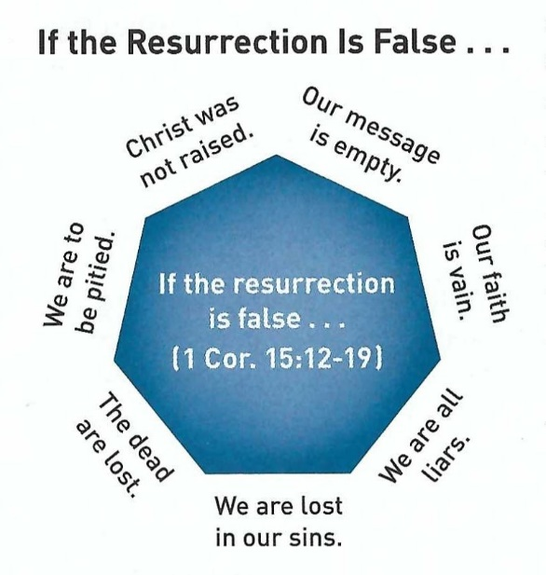
1 Corinthians 15:12-19
If life here on earth is all there is, it makes no sense to base our hope on the groundless promises of one who made empty assertions about eternity.”
Paul tells the Corinthians in no uncertain terms, if there is no resurrection all that we do is empty and pitiful.

Slide 18
1 Corinthians 15:20-28
²⁰But now Christ is risen from the dead, and has become the firstfruits of those who have fallen asleep. ²¹For since by man came death, by Man also came the resurrection of the dead. ²²For as in Adam all die, even so in Christ all shall be made alive. ²³But each one in his own order: Christ the firstfruits, afterward those who are Christ’s at His coming. ²⁴Then comes the end, when He delivers the kingdom to God the Father, when He puts an end to all rule and all authority and power. ²⁵For He must reign till He has put all enemies under His feet. ²⁶The last enemy that will be destroyed is death. ²⁷For “He has put all things under His feet.” But when He says “all things are put under Him,” it is evident that He who put all things under Him is excepted. ²⁸Now when all things are made subject to Him, then the Son Himself will also be subject to Him who put all things under Him, that God may be all in all.

Slide 19
1 Corinthians 15:20-28
Having given, in 15:12-19, a tragic answer to the question, “What if there were no resurrection?” Paul does an about face. With “but now” (15:20), shifting from the hypothetical to the factual, from “what if” to “what is.”
Paul says, “But now Christ is risen from the dead, and has become the first fruits of those who are asleep.” (15:20).
“Those who are asleep” is Paul’s favorite euphemism for believers who have died.
It is not our souls that sleep, once we die our immaterial parts are absent from the body and the earthly realm, and are immediately taken into the presence of the Lord in a place of peace and paradise (Luke 23:43; Phil. 1:21, 23; 2Cor. 5:6, 8; 12:4).

Slide 20
1 Corinthians 15:20-28
We will be fully conscious, pleasantly content, but yet incomplete. Because our bodies will be “sleeping” in the grave, awaiting resurrection.
Our salvation will only be complete when both our immaterial and material parts are reunited– the long awaited redemption of our bodies (Rom. 8:23).
The “first fruit” of our resurrection is the resurrection of Jesus Christ.
Barclay explains the background of “first fruit” from Lev. 23:10-11, submitting that once the barley is gathered, threshed, parched, grounded and made into flour it is then offered to God as the first fruit offering. Only after this process could it be brought, sold, and made into bread.

Slide 21
1 Corinthians 15:20-28
The “first fruit” was “a sign of the harvest to come; just as the Resurrection of Jesus is a sign of the resurrection of all believers which is to come.”
The outcome of Jesus resurrection is that – the death that entered the world through the sin of Adam was reversed by Christ’s resurrection from the dead.
All humanity born “in Adam” are born in a state of mortality, destined to die. However, all who are born again “in Christ,” by the baptism of the Holy Spirit (12:13), will likewise follow suit in Christ’s resurrection.
Like the Hebrew worshiper who took his “first fruits” to the temple, Jesus’ resurrection points to the full harvest to come – the resurrection of the saints.

Slide 22
1 Corinthians 15:20-28
The emphasis now shifts from the past to the future – from Christ’s resurrection to ours (15:23).
Paul explains our resurrection in relation to some upcoming end-times events. He gives few details and focuses on the ultimate destiny of believers.
Here he presents a general outline of a three-stage resurrection process with a clear order of events, but no specific timetable for fulfillment.
FIRST STAGE: Christ the first fruits (15:23). This already occurred when Jesus Christ rose from the dead (Matt. 28). Jesus became the firstborn from the dead (Col. 1:18, Rev. 1:5), indicating that He is the first “among many brethren” (Rom. 8:29).

Slide 23
1 Corinthians 15:20-28
Since Christ’s resurrection, we who believe in Him and are spiritually united to Him by the Holy Spirit are associated with His resurrection, as a guarantee of our own resurrection (Eph. 1:13-14).
SECOND STAGE: Those who are in Christ’s (15:23). This resurrection will occur after an undefined period of time “at His coming.” Those who died believing in Him will be raised as part of the harvest that follows the “first fruits.”
Describing this event, Paul say, “For the Lord Himself will descend from heaven with a shout, with the voice of the archangel and with the trumpet of God, and the dead in Christ will rise first. Then we who are alive and remain will be caught up together with them in the clouds to meet the Lord in the air, and so we shall always be with the Lord” (1Thes. 4:16-17).

Slide 24
1 Corinthians 15:20-28
THIRD STAGE: The unsaved dead (15:24-27). The ultimate end to all of God’s enemies, including death itself, will occur sometime after the resurrection of believers.
We know that the span of time between the first and second stages of the resurrection process has already lasted nearly two thousand years.
While Paul does not tell us the time elapse between the second and third stages, Revelation 20:4-5 tells us that there will be a reign of Christ with His resurrected saints for one thousand years on the earth.
During this earthly reign, Christ will have destroyed all ungodly dominion, authority, and power. Christ will then put all enemies under His feet (15:24-25).

Slide 25
1 Corinthians 15:20-28
At the end of this thousand-year reign, death itself will be destroyed, as all unbelieving souls are raised up to face the judgment of God, and death itself will be thrown into the “lake of fire” – also known as “the second death” (Rev. 20:7-15).
At that point, everything in the universe will have been submitted to the lordship of Christ, functioning under the submission of God the Father (15:27-28).
The transfer of the kingdom back to God the Father indicates that the earthly kingdom of Christ during the thousand year reign will come to an end, and all the redeemed will continue to live in an eternal state under the direct kingship of the Father and the Son.

Slide 26
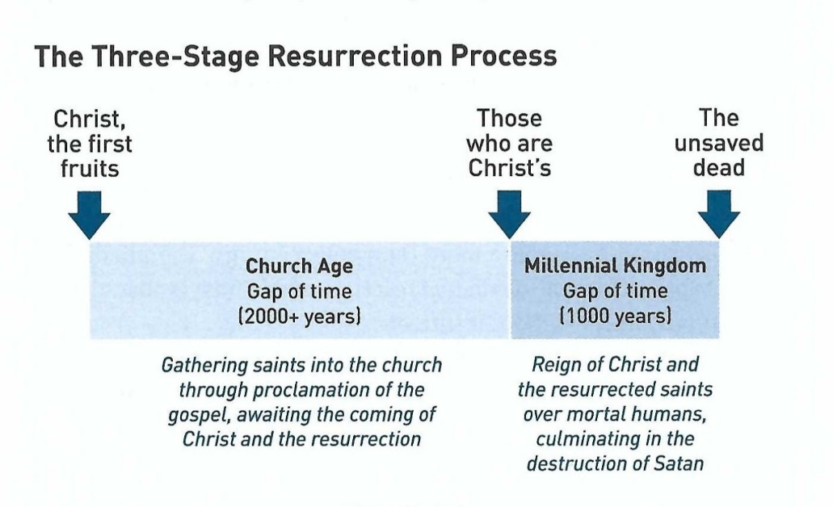
1 Corinthians 15:20-28
This will occur in what the Bible describes as the new heaven and the new earth (Rev. 21- 22:5).
Then and only then will the triune God be universally confessed, praised, worshiped, and served as “all in all” (15:28) – that is, recognized by all as the sovereign Lord with supreme power in the universe.

Slide 27
1 Corinthians 15:29-34
²⁹Otherwise, what will they do who are baptized for the dead, if the dead do not rise at all? Why then are they baptized for the dead? ³⁰And why do we stand in jeopardy every hour? ³¹I affirm, by the boasting in you which I have in Christ Jesus our Lord, I die daily. ³²If, in the manner of men, I have fought with beasts at Ephesus, what advantage is it to me? If the dead do not rise, “Let us eat and drink, for tomorrow we die!” ³³Do not be deceived: “Evil company corrupts good habits.” ³⁴Awake to righteousness, and do not sin; for some do not have the knowledge of God. I speak this to your shame.

Slide 28
1 Corinthians 15:29-34
Paul has thus far pointed to the past (Christ resurrection) and to the future (our coming resurrection). In these next few verses, Paul brings us back to the present to discuss our practical response to these central theological truths.
Paul begins by appealing to the Corinthians practice of baptizing “for the dead” (15:29). If the dead are not raised, why, are people baptized for them?
This passage has prompted many suggestions regarding what Paul is referring to by “baptism for the dead.”
Some include:

Slide 29
1 Corinthians 15:29-34
Baptizing living believers on behalf of loved ones or ancestors who have died.
An aberrant practice of baptism among the Corinthians that adopted pagan rituals of baptizing for the dead.
Washing corpses in preparation of burial to demonstrate the honor of the physical body, which will be resurrected.
Honorary, posthumous baptism for believers who had died prior to being baptized.
Baptism of living converts to take the place of those who had gone on ahead, in anticipation of a reunion of all believers of every age after resurrection.
Baptism in honor of a martyr who had impacted a believer in a special way.

Slide 30
1 Corinthians 15:29-34
We start our interruption by ruling out “baptizing living believers for the benefit of dead ones.” This is not an orthodox Christian belief or practice, only Mormons practice this as a ritual.
However, let’s set the stage for deciding what makes sense for this passage in this context.
First – there is no other passage in the Bible which indicates that Christians should be baptized for the dead.
Second – we should never generate a doctrine out of an obscure text when no other text in the Bible teaches it.
Third – when Paul speaks of those “who are baptized for the dead,” He speaks in the third person.

Slide 31
1 Corinthians 15:29-34
Fourth – we know at the outset of this epistle, that baptism was something in which some took pride and others took sides.
Fifth – baptism seems to have played too important a role to some, and instead of being a symbol of salvation, it was miss interpreted as a “work” for salvation.
Robert L. Deffinbaugh comments about this verse:
“Baptism had taken on too much meaning for some at Corinth. Some looked upon baptism, as a “work” performed by men which was necessary to salvation. If baptism was wrongly considered necessary for salvation, then surely those now dead, who may not have been baptized when they were saved, would be thought to be in trouble.”

Slide 32
1 Corinthians 15:29-34
While Paul’s statement here made more sense to the Corinthians than it does to us, his main point is clear.
If there were no resurrection, such a practice would be nothing more than empty liturgy. The practice of being baptized into the death and resurrection of Christ is absurd if we confess only death without resurrection.
Paul points out that belief in the resurrection ought to affect our attitudes toward this present life (15:30-31).
Motivated by the rewards of immortality in our glorified, resurrected condition, believers are “in danger every hour” (15:30). In fact, giving up their rights, comforts, privileges, and earthly goals, they “die daily” (15:31).

Slide 33
1 Corinthians 15:29-34
The Christian philosophy of life affects even our willingness to risk our physical lives for Christ (15:32).
Weighed against the priceless gift of eternal life, the present earthly treats and treasures become corruptible trinkets of no value.
In addition to the revaluing of our earthly life, Paul also notes that the resurrection should affect our moral behavior. If we are living only for this life, the indulgent, and the hedonistic philosophy makes sense: “Let us eat and drink, for tomorrow we die” (15:32).
If there is no reward in eternity, then why not live it up? Why not say yes to any and all craving of the flesh?

Slide 34
1 Corinthians 15:29-34
Why not hang out with the restless and rebellious crowd, party until dawn, and live a life of fun-filled debauchery, flushing all virtues and morals down the toilet (15:33)?
If the rejection of the resurrection, eternal life, and future rewards leads to immorality and sin, then belief in the resurrection should lead to a life characterized by sober minded judgment and holiness (15:34).

Slide 35
Applications
Of the
lesson
Raised to Newness of Life

Slide 36
Application – Raised to Newness of life
In closing Swindoll says . . . After arguing from an “if-there-were-no-resurrection” perspective Paul gives us three commands to obey in light of the truth of the resurrection, that provide clear, direct application for our lives today.
First – “Bad company corrupts good morals” (15:33) – quoting a Greek proverb. Paul urges us to listen discerningly, distinguishing right doctrine and practice from the false opinions of the crowd and the depraved culture around us.
If we become enmeshed with ungodly people, their philosophies will become our own. As we are increasingly “baptized” by the culture’s values, beliefs, and practices, our baptism into the death and resurrection of Christ will become less and less a part of our character.

Slide 37
Application – Raised to Newness of life
Are you aware of the dangers of the world’s deceptive philosophies? Do you surround yourself with Godly people to imitate?
Consider the various worldly influences that bombard you with their deceptive message: TV, radio, Internet, schools, etc. then consider the number of positive Christian influences in your life.
How can you help balance these, putting to death the philosophies of the world and breathing new life into your Christian worldview?
Second – “Become sober minded as you ought” (15:34) – we must be aware of how easy it is to slip into a clueless slumber or stumble into a passive stupor.

Slide 38
Application – Raised to Newness of life
With each poisonous dose of the world’s intoxicating brew of temptations, we increasingly find ourselves obsessed with its tune of “Eat, drink, and be merry, for tomorrow we shall die.”
We have got to wake up to the fact that our society devours personal identity, encouraging mechanistic living and group-think philosophies. To do this, we need to renew our minds (Rom. 12:2).
We need to take our thoughts captive to the obedience of Christ (2Cor. 10:5). To dwell on things that are true, pure, right, honorable, lovely, excellent, and praise worthy (Phil 4:8).
Living like that results in putting to death the deeds of the flesh and walking in the newness of life (Rom. 6:4).

Slide 39
Application – Raised to Newness of life
Third – “Stop sinning” (15:34) – In light of our claim to know God intimately and to have a personal relationship with Him through Jesus Christ, we must listen with a sensitive heart to the voice of the indwelling spirit who convicts of sin.
We should keep short accounts, confessing our sin and being cleansed from all unrighteousness (1John 1:8-10; 1Peter 1:14-16).
Nothing is as exciting, satisfying, or rewarding as turning away from the deeds of the flesh through the enabling power of the holy spirit (Rom 8:13).
So, as we await the resurrection and transformation of our mortal bodies at the return of Christ, let’s put to death the attitudes and actions of the flesh, and let’s renew our minds, modeling the resurrected life by the power of the Holy Spirit.

Slide 40


“Living in Light of the Resurrection”

Slide 41

NEXT CLASS – 06 December 2023
Book of First Corinthians
Before next class, read the below chapters in the NKJV and in one other versions of the Bible, i.e., KJV, NRSV, NIV, CEV, etc …
Chapter 15:35 – 49
“Our Future Bodies”

